Slide 1
Global Palm Oil
Market Outlook
David Hightower

Slide 2
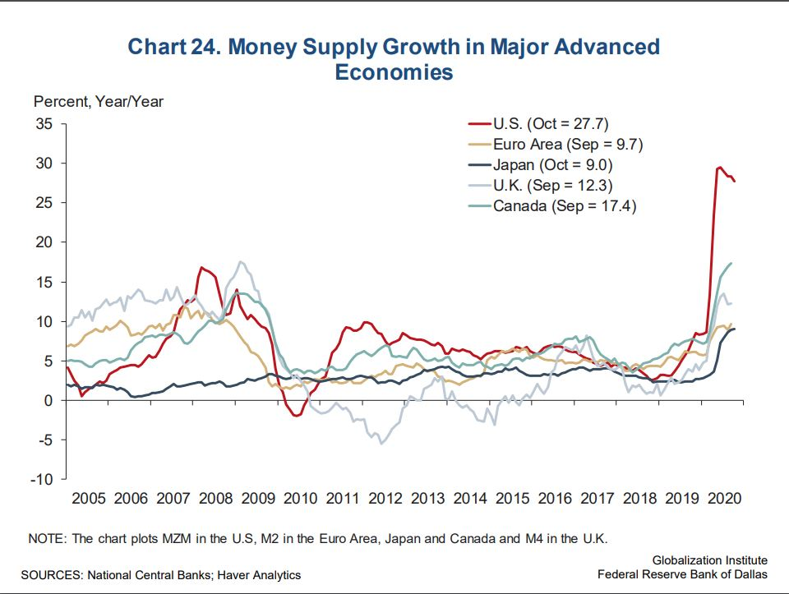

Slide 3
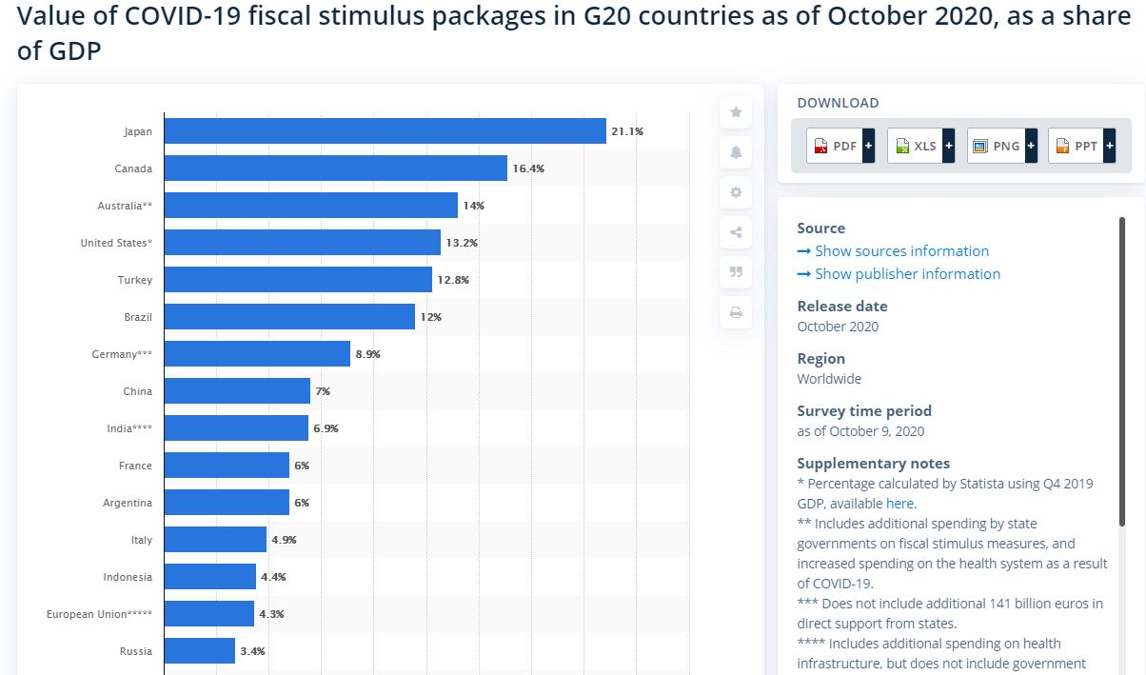

Slide 4
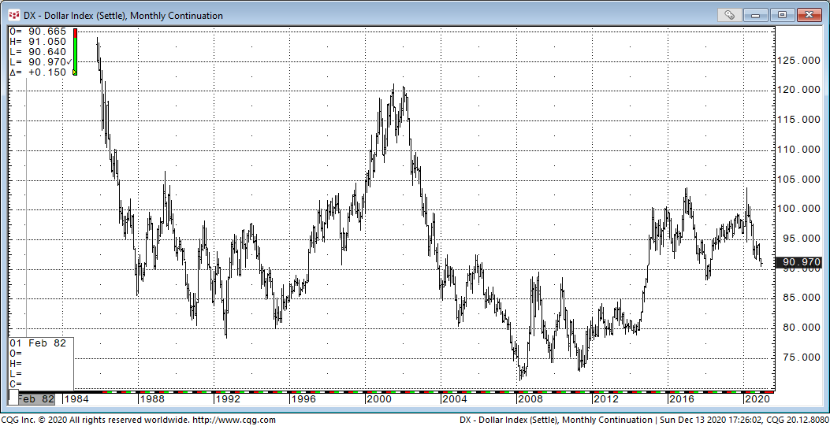
World Reserve Currency Safe Haven Growth Leader
Global Citizen Tide

Slide 5
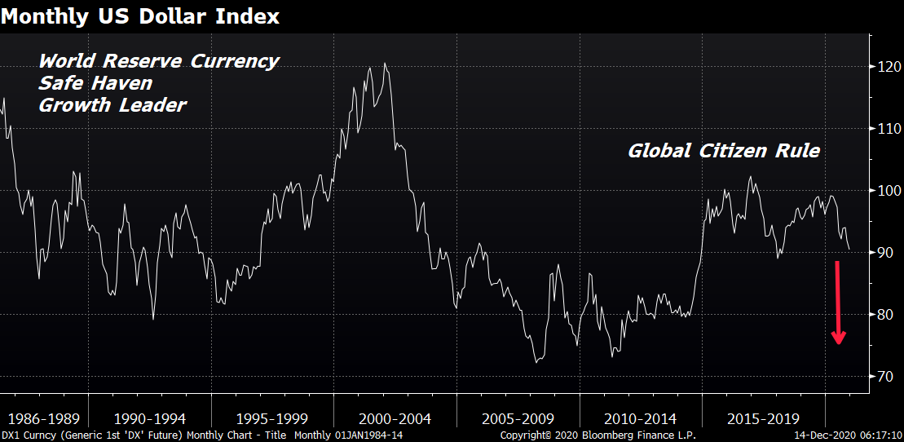

Slide 6
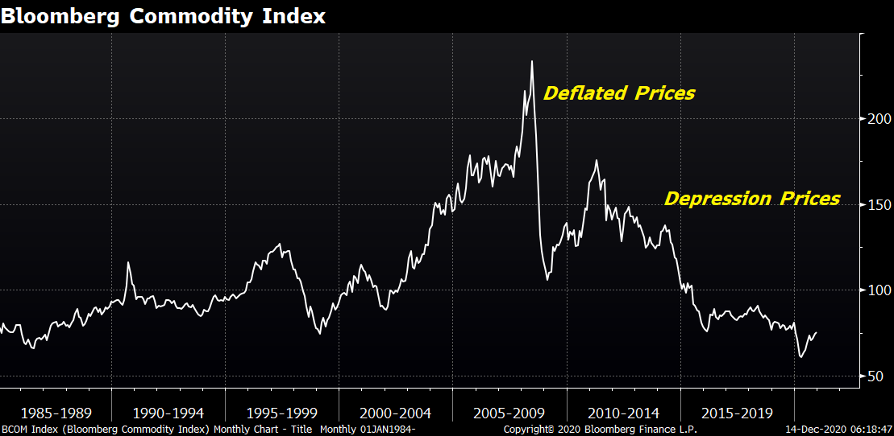
Goldman CITI Commodity Bull Market

Slide 7
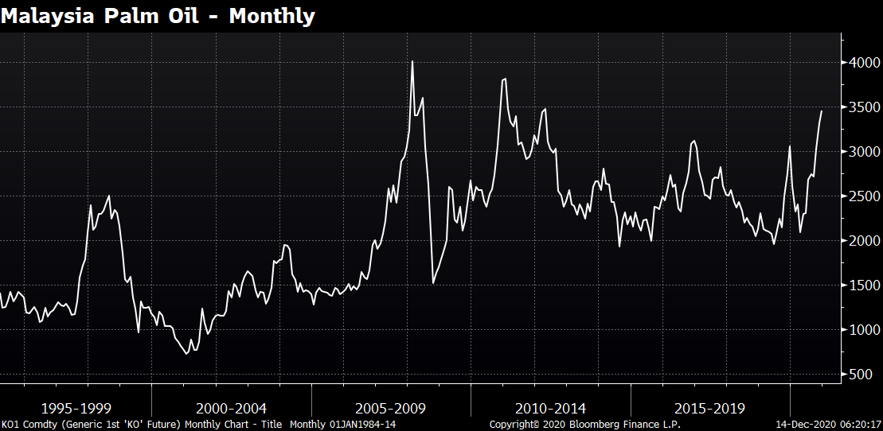

Slide 9
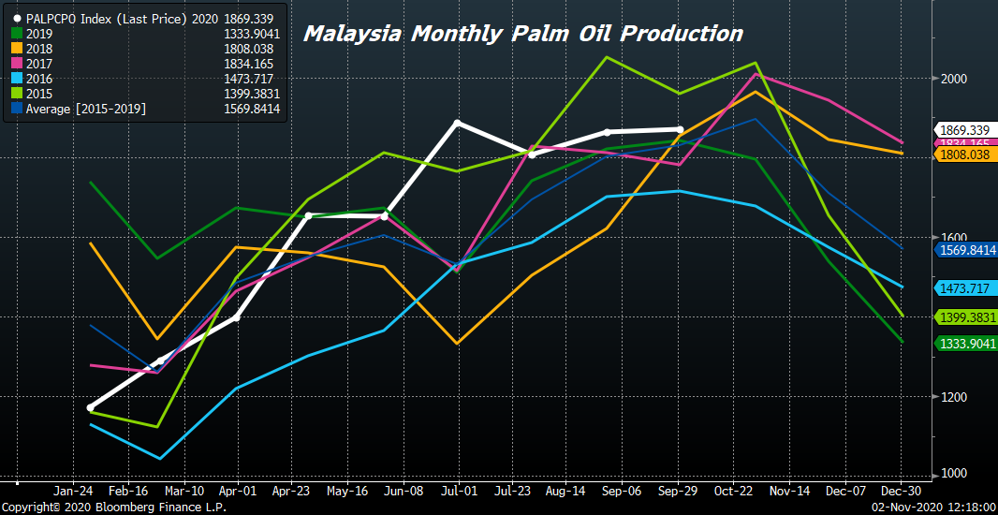
Production seasonally peaking

Slide 12
Most Needs Will Come From Record Soy Crush

Slide 13
Big Recovery 2021 if Virus Under Control

Slide 14
Long-Term Demand Issues Bullish

Slide 17
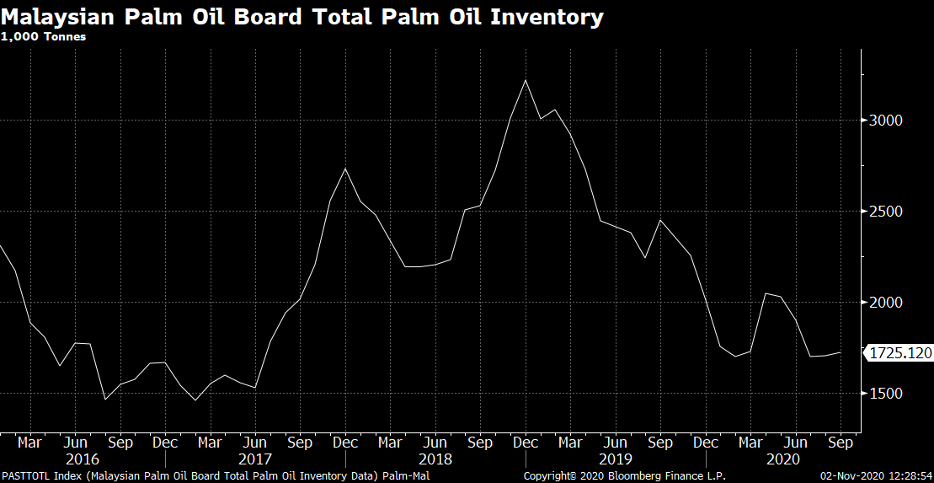

Slide 18
Short-term forces
Declining palm production, recovery in energy and tightening stocks supported recent run-up
World palm prod expected to reach record in 2020/21, but stocks are expected to fall to 4-yr low, stocks/usage ratio to 13%, 33-yr low
Indonesia prod record high 5th year in a row 2021
Record soyoil prod could help the market put in a significant peak in early 2021.

Slide 19
More forces
China may not as much palm oil this year
Huge feed requirements in China, building crush capacity and boosting soybean imports.
An expanded crush means they will be producing more soybean oil, reduce vegoil import needs.
India’s veg oil imports year ending Oct were est at 13.5-13.6 mmt, down from 15.55 mmt previous yr
Another issue 2021 biodiesel consumption; took big hit first half of 2020.
La Niña, expected to bring favorable growing weather to SE Asia but too much rain/ virus employee issues short-term.

Slide 20
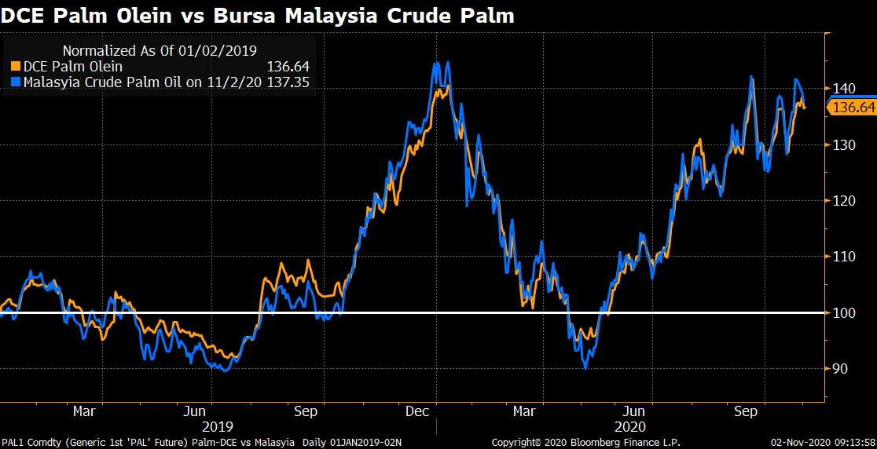
Strong correlation in $/ton since 2019

Slide 21
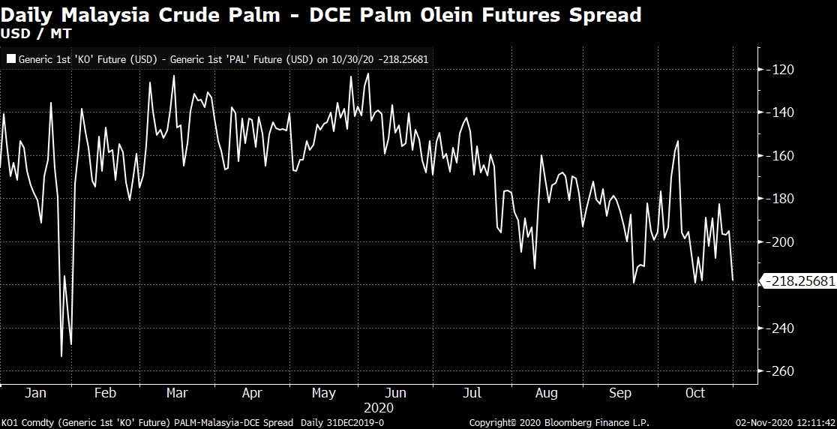
Spread Trade – Year to Date

Slide 22
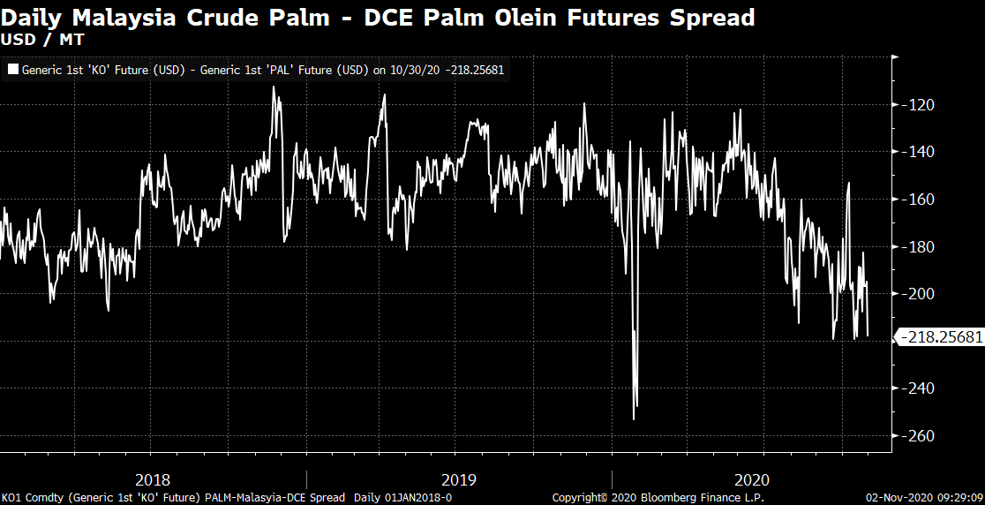
Spread Trade - Last 3 Years

Slide 23
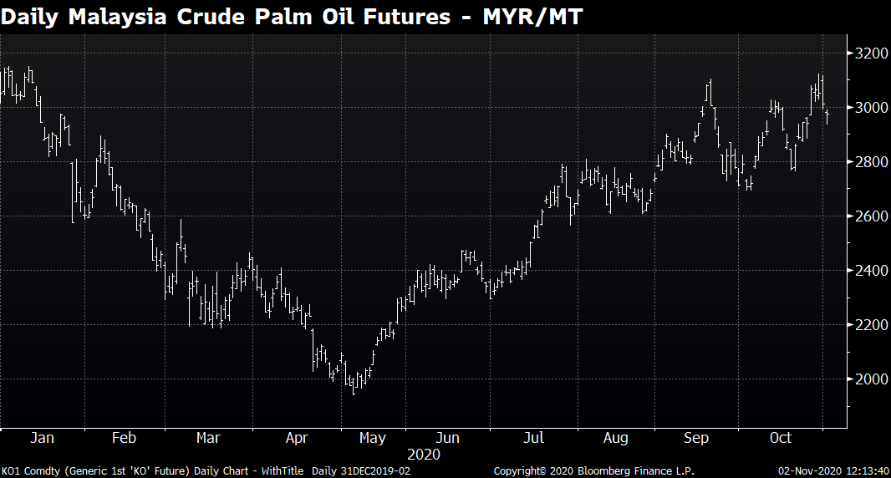
Strong solid uptrend

Slide 24
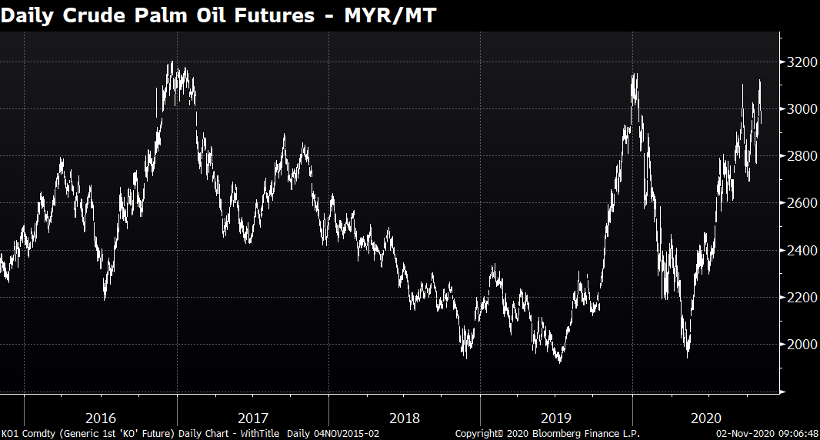
Surge to 8-yr high; stocks to 3-yr low

Slide 25
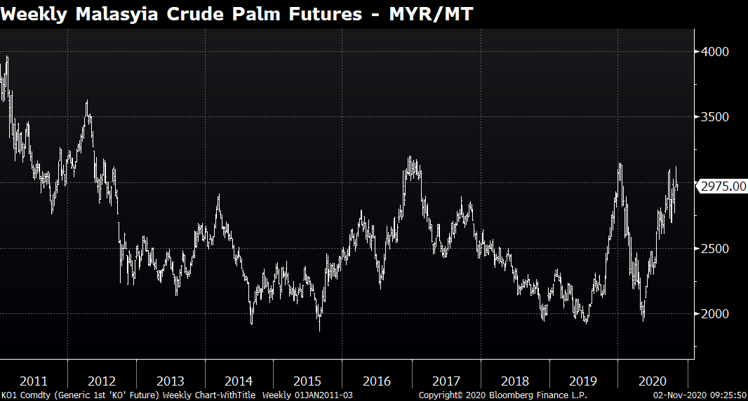
Very volatile last 1 ½ years

Slide 26
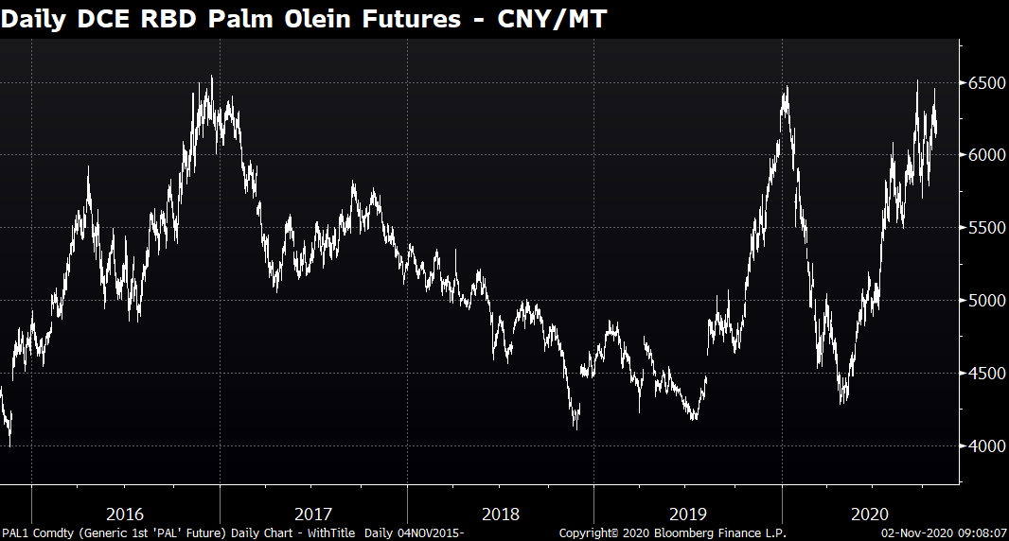

Slide 27
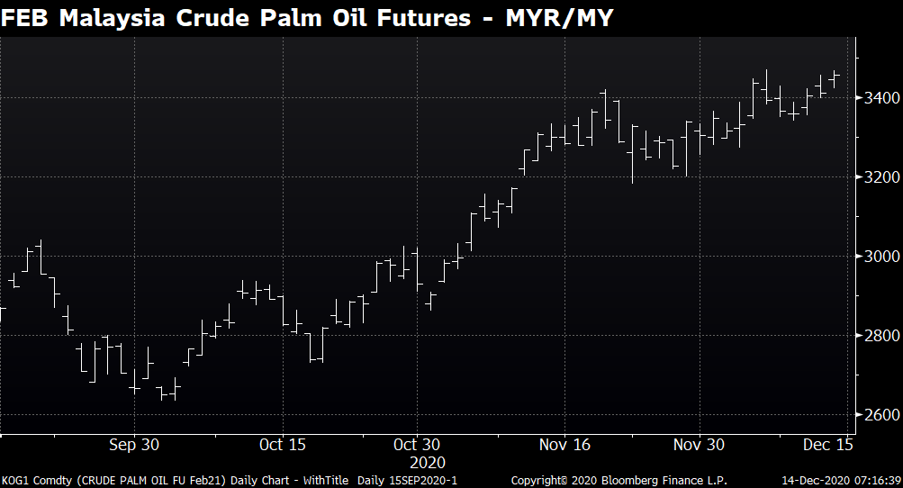

Slide 28
